Slide 1
Principal Component Analysis (PCA)
Presented by Farzad Mozafari
Instructor Dr. Yasser Alginahi
Date November 10, 2023

Slide 2
Outline of the Presentation
Introduction
Objectives of PCA
Pseudocode of PCA
Terminology
Algorithm
PCA with Python
Applications
Conclusion
References

Slide 3
Introduction (feature reduction )
Feature reduction refers to the mapping of the original high-dimensional data
onto a lower-dimensional space.[6]
Criterion for feature reduction [3] can be different based on different problem settings.
Unsupervised setting: Minimize the information loss.
Supervised setting: Maximize the class discrimination.
Why feature reduction?
Visualization: Projection of high-dimensional data onto 2D or 3D.[2]
Most machine learning and data mining techniques may not be effective for high-dimensional
data [5].
Query accuracy and efficiency degrade rapidly as the dimension increases.
Data compression: Efficient storage and retrieval.
Noise removal: Positive effect on query accuracy.

Slide 4
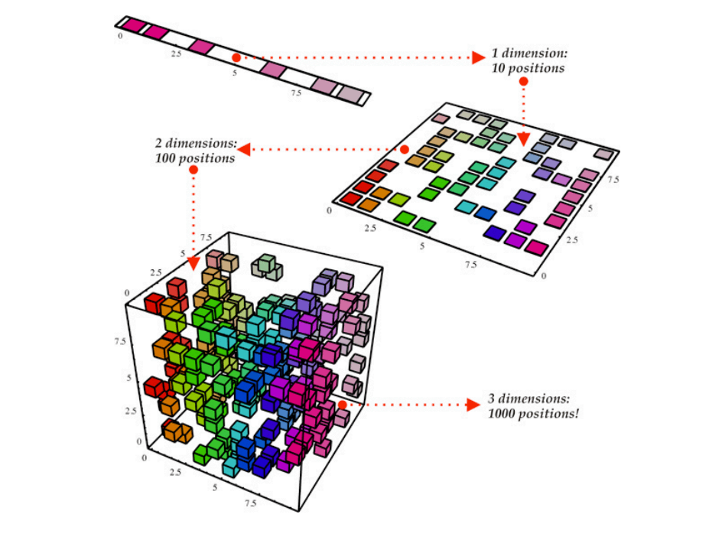
Feature reduction algorithms
Unsupervised
Latent Semantic Indexing (LSI): truncated SVD
Independent Component Analysis (ICA)
Principal Component Analysis (PCA) [1]
Canonical Correlation Analysis (CCA)
Supervised
Linear Discriminant Analysis (LDA)
Semi-supervised
Research topic
Application of feature reduction
Reduce number of dimensions in data.
Find patterns in high-dimensional data.
Visualize data of high dimensionality.
Fig. 1. reduction of features from 3 to 1.
https://tinyurl.com/ybhspnry [7]

Slide 5
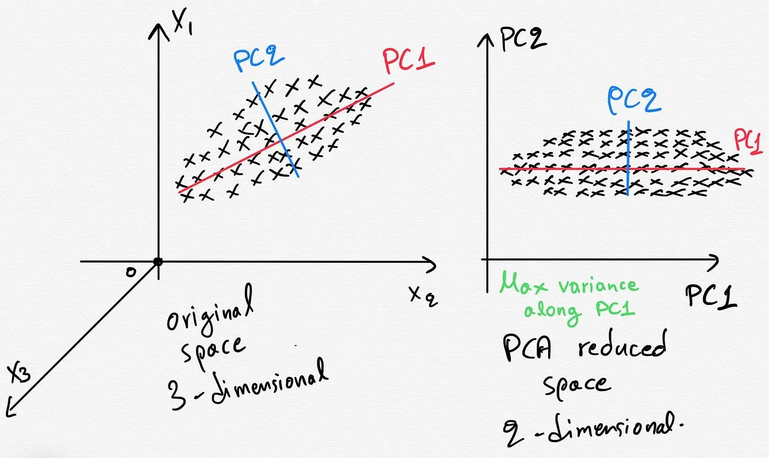
Principal Component Analysis (PCA)
Principal Component Analysis (PCA)
Reduce the dimensionality of a data set by finding a new set of variables, smaller than the original set of variables
Retains most of the sample's information.
Useful for the compression and classification of data.
Fig. 2: Transformation of the data from 3D feature space to 2d feature space.
https://tinyurl.com/yfhywe27 [8]

Slide 6
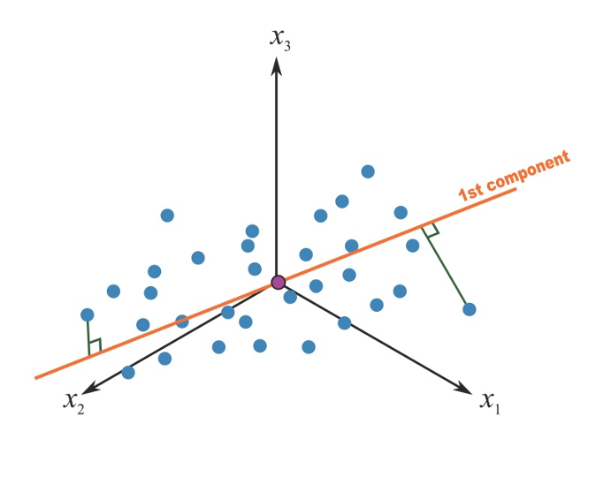
Objectives of PCA
Principal Component Analysis is a technique used to:
Reduce the dimensionality of the data set
Identify new meaningful underlying variables
Loose minimum information
N dimensional data is taken, and M orthogonal directions
are found.
It means that the data has the most variance.
These principal directions of M form a lower dimensional subspace.
An N-dimensional data point can be represented by its predictions
in the main directions of M.
Fig. 3. First principal component in a 3-covariates setting. https://tinyurl.com/yefpr7uh [11]

Slide 7
Pseudocode of PCA
Standardization
Importance of data standardization with mean and standard deviation.[2]
PCA relies on the assumption of normal distribution of data and is very sensitive to the characteristic
or variance of the variable.[4, 9]
Compute the covariance matrix
Covariance matrix, a square matrix containing data variance and variable covariance [1].
Quantifying the relationship between variables through a covariance matrix [3].
Basically, providing an empirical picture of the data [1] and revealing the correlations between the characteristics of the data.
Compute eigenvectors and eigenvalues from the covariance matrix
Calculation of eigenvectors and eigenvalues to identify the principal components that record the most variance of the data.
Showing the direction of data dispersion or the highest variance with eigenvectors [3].
Relative importance of directions with eigenvalues [3].
Compute the feature vector and principal components
The eigenvectors act as principal components, while the eigenvalues determine their relative importance.
It is noteworthy that all eigenvectors are perpendicular to the vector before them [10].
Project the data onto the selected principal components for dimensionality reduction
Considering the two main components out of the four components, reduce the dimensions of the data using the following formula [4].
Final Data Set= Standardized Original Data Set * Feature Vector

Slide 8
Terminology
Variance
Covariance
Eigenvectors & Eigenvalues
Principal Components

Slide 9
Terminology (Variance)
Standard deviation:
Average distance from mean to a point
Variance:
Standard deviation squared
One-dimensional measure
(1)

Slide 10
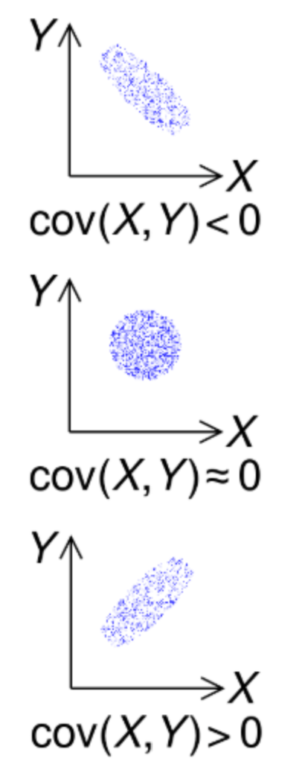
Terminology (Covariance)
How two dimensions vary from the mean with respect
to each other
(2)
cov(X,Y) > 0: Dimensions increase together
cov(X,Y) < 0: One increases, one decreases
cov(X,Y) = 0: Dimensions are independent
https://tinyurl.com/ehvj84x7

Slide 11
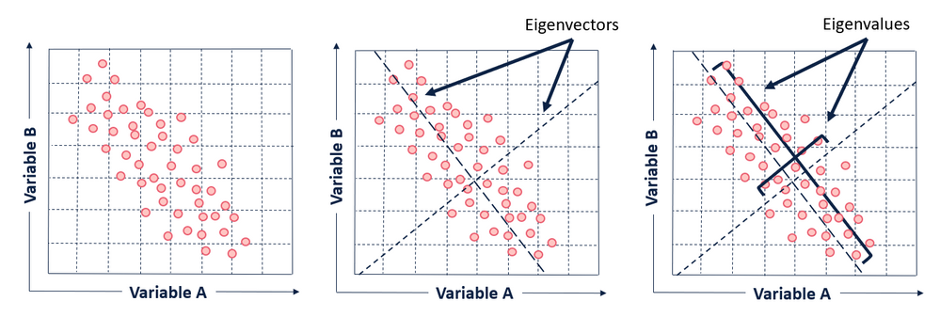
Terminology (Eigenvalues & Eigenvectors)
Eigenvalues measure the amount of the variation explained by each PC (largest for the first PC and smaller for the subsequent PCs).
The extracted uncorrelated components are called Principal Components (PC).
Eigenvectors provides the weights to compute the uncorrelated PC. These vectors give the directions in which the data cloud is stretched most.
Fig 4. Eigenvectors and eigenvalues of the dataset with two variables A & B taken from
https://tinyurl.com/5czfny39 [10].

Slide 12
Terminology (cont’d)
Vectors x having same direction as Ax are called eigenvectors of A
(A is an n-by-n matrix).
In the equation Ax=λx, λ is called an eigenvalue of A. [4]
Ax=λx ⇔ (A-λI)x=0
How to calculate x and λ:
Calculate det(A-λI), yields a polynomial (degree n).
Determine roots to det(A-λI)=0, roots are eigenvalues λ.
Solve (A- λI) x=0 for each λ to obtain eigenvectors x.
(3)

Slide 13
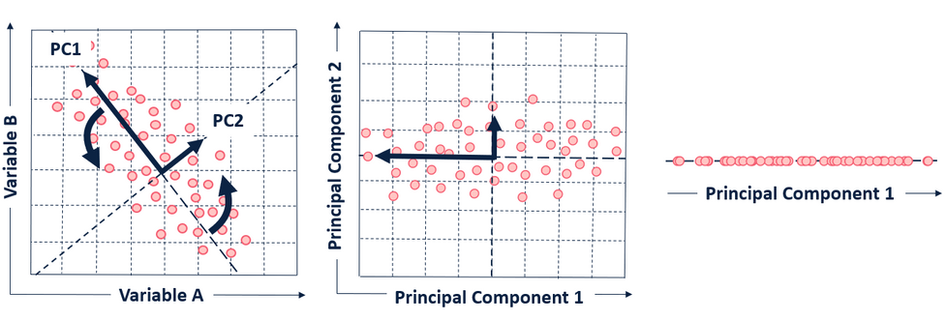
Algorithm
Finding the axes that minimize the projection errors and maximize the variance after the projection
n-dimensional
vectors
m-dimensional
vectors
m < n
Fig. 5. Visual representation of principal components one and two that fit on the dataset.
https://tinyurl.com/5czfny39 [10].

Slide 14
PCA with Python
The purpose of principal component analysis is to find the best low-dimensional representation of the variation in a multivariate data set. PCA not only removes some redundancy, but also improves the variance of the data set.
PCA not only removed some redundancy but also improved variance in the dataset.
For example, in the case of the wine data set, we have 13 chemical concentrations describing wine samples from three different cultivars.
"wine.csv" [12] dataset has a large number of features (columns), PCA can help in reducing the dimensionality by transforming the data into a set of linearly uncorrelated variables (principal components). This is particularly useful when dealing with datasets where the number of features is significantly greater than the number of observations.

Slide 15
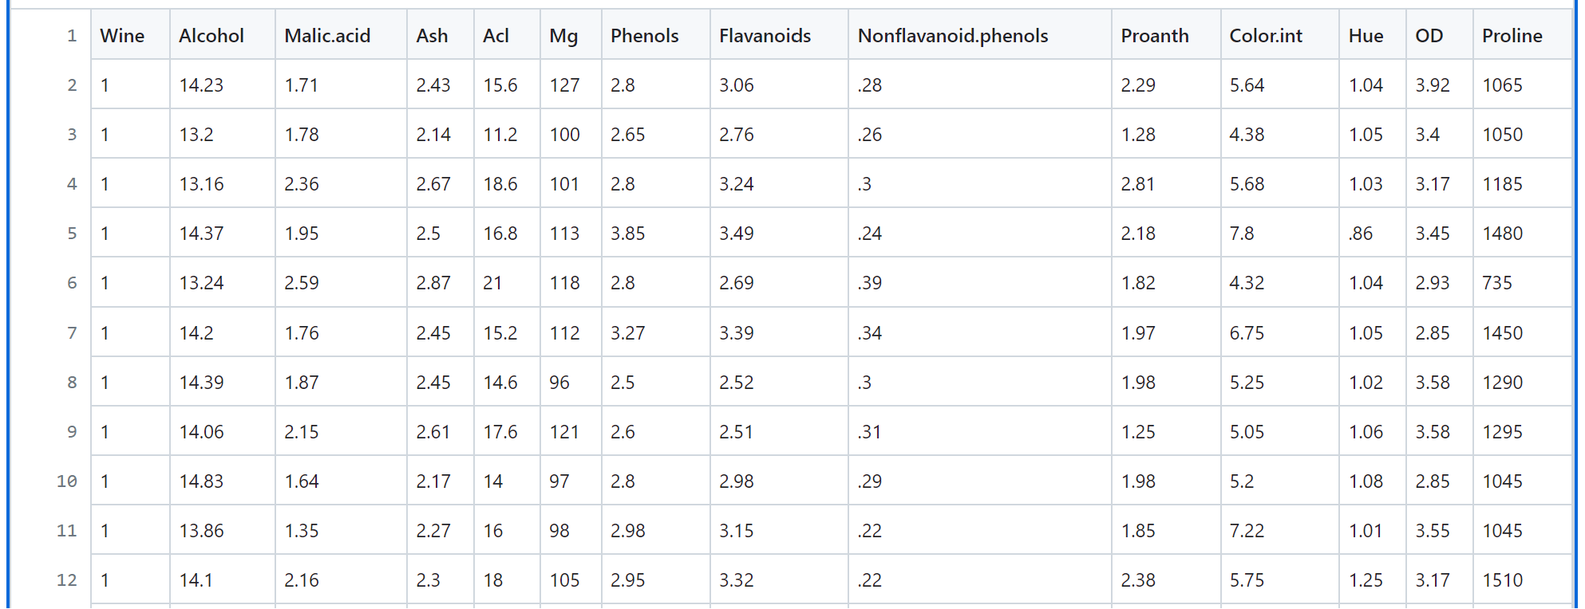
PCA with Python (Considering wine.csv dataset) (https://tinyurl.com/xa8f35u6 [13] )
Considering wine.csv dataset
Step 1: Import the libraries.
import numpy as nmp
import matplotlib.pyplot as mpltl
import pandas as pnd
Step 2: Import the dataset (wine.csv).
DS = pnd.read_csv('Wine.csv')
# Now, distribute the dataset into two components "X" and "Y"
X = DS.iloc[: , 0:13].values
Y = DS.iloc[: , 13].values
Step 3: Split the dataset into the training set and testing set.
from sklearn.model_selection
import train_test_split as tts
X_train, X_test, Y_train, Y_test = tts(X, Y, test_size = 0.2, random_state = 0)
Step 4: Feature Scaling (reprocessing on the training and test set (for example, standard scale fitting.)
from sklearn.preprocessing import StandardScaler as SS
SC = SS()
X_train = SC.fit_transform(X_train)
X_test = SC.transform(X_test)
Fig. 6. wine.csv https://tinyurl.com/bdfakpab [12]

Slide 16
PCA with Python (cont’d)
Step 5: Then, Apply the PCA function ( Apply the PCA function into the training set and testing set for analysis.)
from sklearn.decomposition import PCA
PCa = PCA (n_components = 1)
X_train = PCa.fit_transform(X_train)
X_test = PCa.transform(X_test)
explained_variance = PCa.explained_variance_ratio_
Step 6: Fit Logistic Regression for the training set.
from sklearn.linear_model import LogisticRegression as LR
classifier_1 = LR (random_state = 0)
classifier_1.fit(X_train, Y_train)
LogisticRegression(random_state=0)
Step 7: Predict the testing set result.
Y_pred = classifier_1.predict(X_test)
Step 8: Create the confusion matrix.
from sklearn.metrics import confusion_matrix as CM
c_m = CM (Y_test, Y_pred)

Slide 17
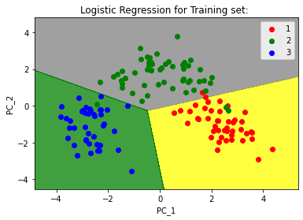
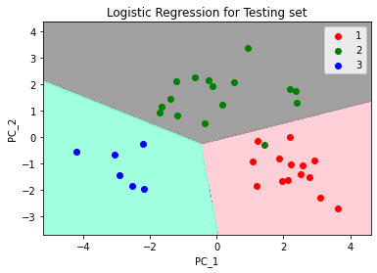
PCA with Python (cont’d)
Step 9: Predict the result of the training set.
from matplotlib.colors import ListedColormap as LCM
X_set, Y_set = X_train, Y_train
X_1, X_2 = nmp.meshgrid(nmp.arange(start = X_set[:, 0].min() - 1,
stop = X_set[: , 0].max() + 1, step = 0.01),
nmp.arange(start = X_set[: , 1].min() - 1,
stop = X_set[: , 1].max() + 1, step = 0.01))
Step 10: Visualize the result of the testing set.
from matplotlib.colors import ListedColormap as LCM
X_set, Y_set = X_test, Y_test
X_1, X_2 = nmp.meshgrid(nmp.arange(start = X_set[: , 0].min() - 1,
stop = X_set[: , 0].max() + 1, step = 0.01),
nmp.arange(start = X_set[: , 1].min() - 1,
stop = X_set[: , 1].max() + 1, step = 0.01))
mpltl.contourf(X_1, X_2, classifier_1.predict(nmp.array([X_1.ravel(),
X_2.ravel()]).T).reshape(X_1.shape), alpha = 0.75,
Fig. 7. Predicting the training set result. https://tinyurl.com/xa8f35u6 [13]
Fig. 8. Visualizing the Test set results. https://tinyurl.com/xa8f35u6 [13]

Slide 18
Applications
Example applications:( https://tinyurl.com/4nyk94p9 [14] )
Computer Vision
Representation
Pattern Identification
Image compression
Face recognition
Gene expression analysis
Purpose: Determine core set of conditions for useful gene comparison
Handwritten character recognition
Data Compression, etc.

Slide 19
Conclusion
PCA can be useful when there is a severe high-degree of correlation present in the multi-attributes.
When a data set consists of several clusters, the principal axes found by PCA usually pick projections with good separation. PCA provides an effective basis for feature extraction in this case.
For good data compression, PCA offers a useful self-organize learning procedure
PCA requires to diagonalise matrix C (dimension:n x n). Heavy if n is large !
PCA only finds linear sub-spaces
It works best if the individual components are Gaussian-distributed
PCA does not say how many target dimensions to use

Slide 20
References
http://wiki.pathmind.com/eigenvector
https://www.geeksforgeeks.org/ml-principal-component-analysispca/
https://blog.clairvoyantsoft.com/eigen-decomposition-and-pca-c50f4ca15501
https://www.turing.com/kb/guide-to-principal-component-analysis
https://en.wikipedia.org/wiki/Dimensionality_reduction
https://www.geeksforgeeks.org/dimensionality-reduction/
https://www.pinecone.io/learn/dimensionality-reduction/
https://towardsdatascience.com/pca-clearly-explained-how-when-why-to-use-it-and-feature-importance-a-guide-in-python-7c274582c37e
https://erdogant.github.io/pca/pages/html/Algorithm.html
https://community.alteryx.com/t5/Data-Science/Tidying-up-with-PCA-An-Introduction-to- Principal-Components/ba-p/382557
https://bookdown.org/andreabellavia/mixtures/principal-component-analysis.html
https://gist.github.com/tijptjik/9408623#file-wine-csv
https://www.geeksforgeeks.org/principal-component-analysis-with-python/
https://colab.research.google.com/github/jakevdp/PythonDataScienceHandbook/blob/master/notebooks/05.09-Principal-Component-Analysis.ipynb

Slide 21
Thank you for attention

